Slide 1
Asbestos in NSW
Communication toolkit
February 2024
Department of Customer Service

Slide 2
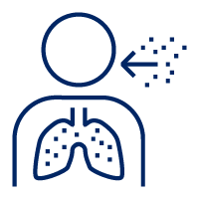




Purpose of this toolkit
We have developed this toolkit to help you communicate important information about asbestos and the steps the NSW Government is taking.
Thank you for your support in sharing this important information with your communities, employees and networks.
How to use this toolkit​
The toolkit contains information and easy to share resources including suggested text for newsletters which can be easily copied and pasted, a factsheet, media releases, and social content.
To download resources:​
Click on the accompanying link which will take you to the nsw.gov.au website or Dropbox​
For nsw.gov.au links, click ‘Download as PDF’ or ‘Print this page’. For Dropbox, on the upper right-hand side you will see a ‘Download' button ​
Click ‘Download’ or ‘Save as PDF’.
Quick links to important information:
Asbestos in NSW
EPA investigation
Submit an EPA investigation enquiry
Asbestos and health fact sheet
SafeWork NSW asbestos resources

Slide 3
What is asbestos?
Asbestos is a natural mineral that was used in many building products before it was banned in Australia.
Asbestos fibres can pose a risk to health if they are airborne, as inhalation is the main way that asbestos enters the body.
Asbestos is common in homes and structures built before 1990 and was commonly used in:
cement sheeting (fibro)
drainage and flue pipes
roofing, guttering and flexible building boards (eg Villaboard, Hardiflex, etc.). Similar cement sheeting products are used today, but are 'asbestos free'
brakes, clutches and gaskets.
For more information, please visit the Asbestos in NSW website.

Slide 4
NSW Asbestos Taskforce
The NSW Government is acting following the discovery of asbestos in mulch in some sites in NSW.
We have announced an Asbestos Taskforce to support the NSW Environment Protection Authority’s (EPA's) investigation into asbestos in mulch.
The taskforce includes senior representatives from NSW Government agencies and local government. It will help co-ordinate government agencies and help prioritise sites that are highest risk to the public, to ensure all resources are available to secure and remediate sites.
The government’s number one priority is “contact tracing” down the complex supply chain, and then facilitating testing, reporting and management of any positive results.
The EPA will provide daily updates on impacted sites.
For more information or to make an asbestos enquiry, please visit the EPA website.

Slide 5
Asbestos and health
Living or working with asbestos, or just being around it, is low risk as long as the asbestos is in good condition and not disturbed. Asbestos occurs naturally and in the built environment. However, asbestos related illness in NSW is very uncommon.
Different forms of asbestos have different risk levels:
Bonded (non-friable) asbestos: if asbestos is mixed with cement or other hard bonding materials, and in good condition, it is likely to be low-risk.
Friable asbestos: can be crumbled, pulverised or reduced to a powder by hand pressure. If asbestos fibres then become airborne and breathed in, they can be a health risk. This is the most common way asbestos enters the body. The more fibres that are breathed in, the higher the risk.
If asbestos-containing materials are disturbed, fibres may be released into the air. Breathing in asbestos fibres can cause asbestosis, lung cancer and mesothelioma.
The risk of contracting these diseases increases with the number of fibres inhaled. The risk of lung cancer from inhaling asbestos fibres is also greater if you smoke.
People who get health problems from inhaling asbestos have usually been exposed to high levels of asbestos for a long time. The symptoms of these diseases do not usually appear until about 20 to 30 years after the first exposure to asbestos.
For more information on asbestos and health risks, please visit health.nsw.gov.au or download a factsheet.

Slide 6
Asbestos in recycled mulch
Recycled mulch must not contain asbestos or any material likely to cause pollution. The EPA regularly audits producers and suppliers of recycled mulch and has a zero-tolerance approach to the presence of asbestos.
The EPA conducts regular compliance audits and campaigns, which can include unannounced inspections of resource recovery facilities. Businesses and individuals that allow any asbestos waste to be reused or recycled face significant penalties and can be fined up to $2 million.
To mitigate health risks, the EPA has issued a Clean Up Notice to Transport for NSW for the removal of all mulch in the Rozelle Parklands and surrounds by 29 February 2024. The EPA has issued a Prevention Notice to the supplier of the mulch to ensure this product cannot be on sold while the investigation is continuing. This was followed up by the issue of a Clean-Up Notice, directing the supplier to notify all customers who received the identified mulch.
To understand the extent of the issue and protect the community, the EPA is investigating other sites that have received mulch from the same supplier.
What should a member of the public do if they believe they have received asbestos-contaminated mulch?
Members of the public and businesses who are concerned about contamination in mulch they have received or on sold should contact the EPA Environment Line on 131 555 or email info@epa.nsw.gov.au.
Parents and guardians who are concerned about asbestos-contaminated mulch on school sites should contact their school for further information and advice.
For more information, please visit the EPA website.

Slide 7
SafeWork NSW asbestos information
If asbestos-containing material is in good condition it poses little health risk. However, when products containing asbestos are disturbed by cutting, drilling, water blasting or similar activities, small fibres may be released into the air.
You must always use a licensed asbestos professional to remove friable asbestos and when there is more than 10sqm of non-friable (bonded) asbestos.
However, due to the risks associated with disturbing asbestos, SafeWork NSW recommends you use a licensed asbestos professional to remove any amount of asbestos.
For more information for asbestos workers or on asbestos in the workplace, visit the SafeWork NSW website.

Slide 8
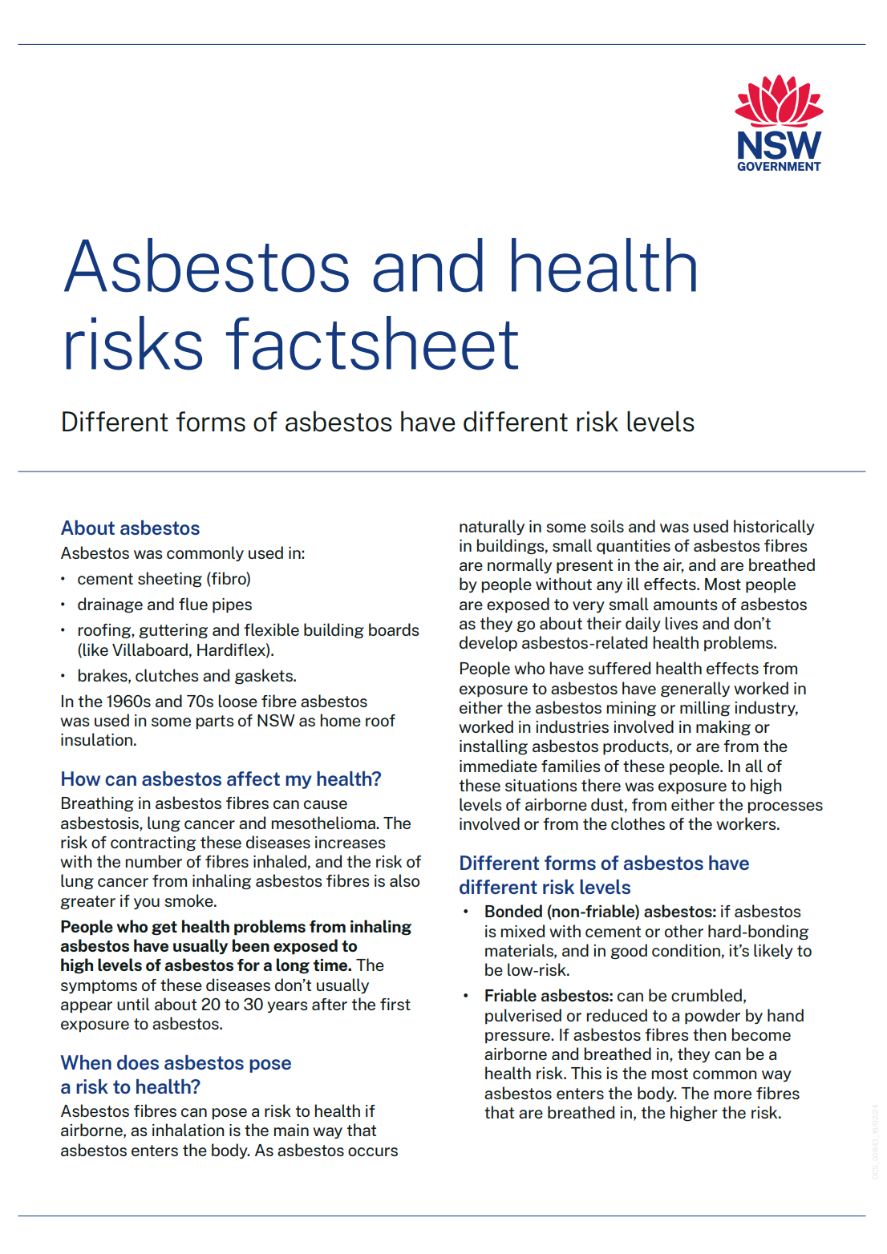
Factsheet: Asbestos and health
Click here to download factsheet

Slide 9
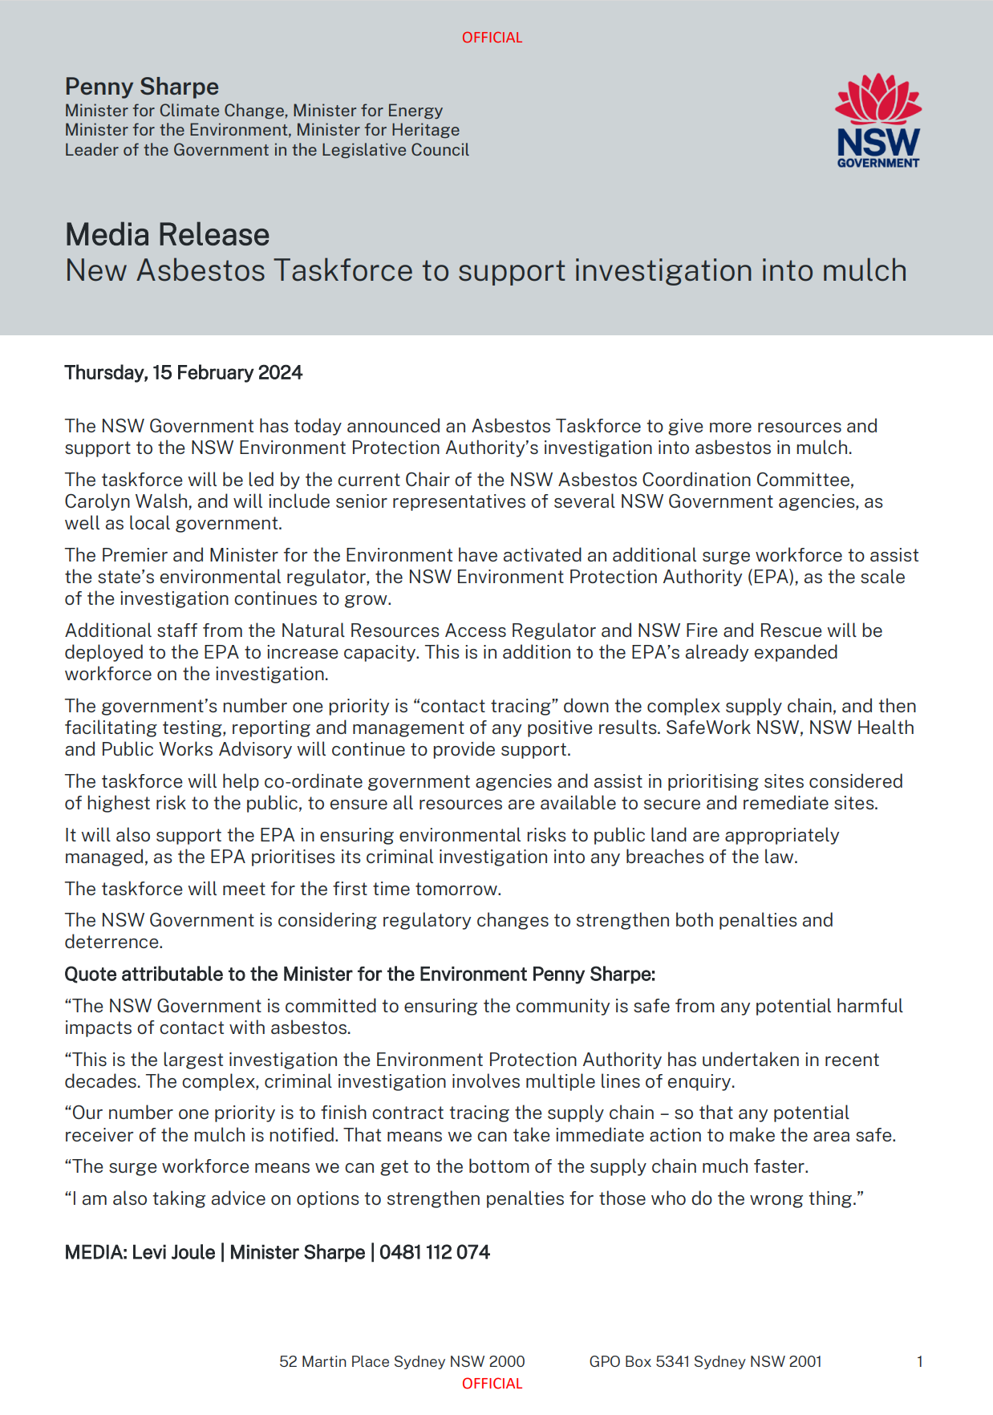
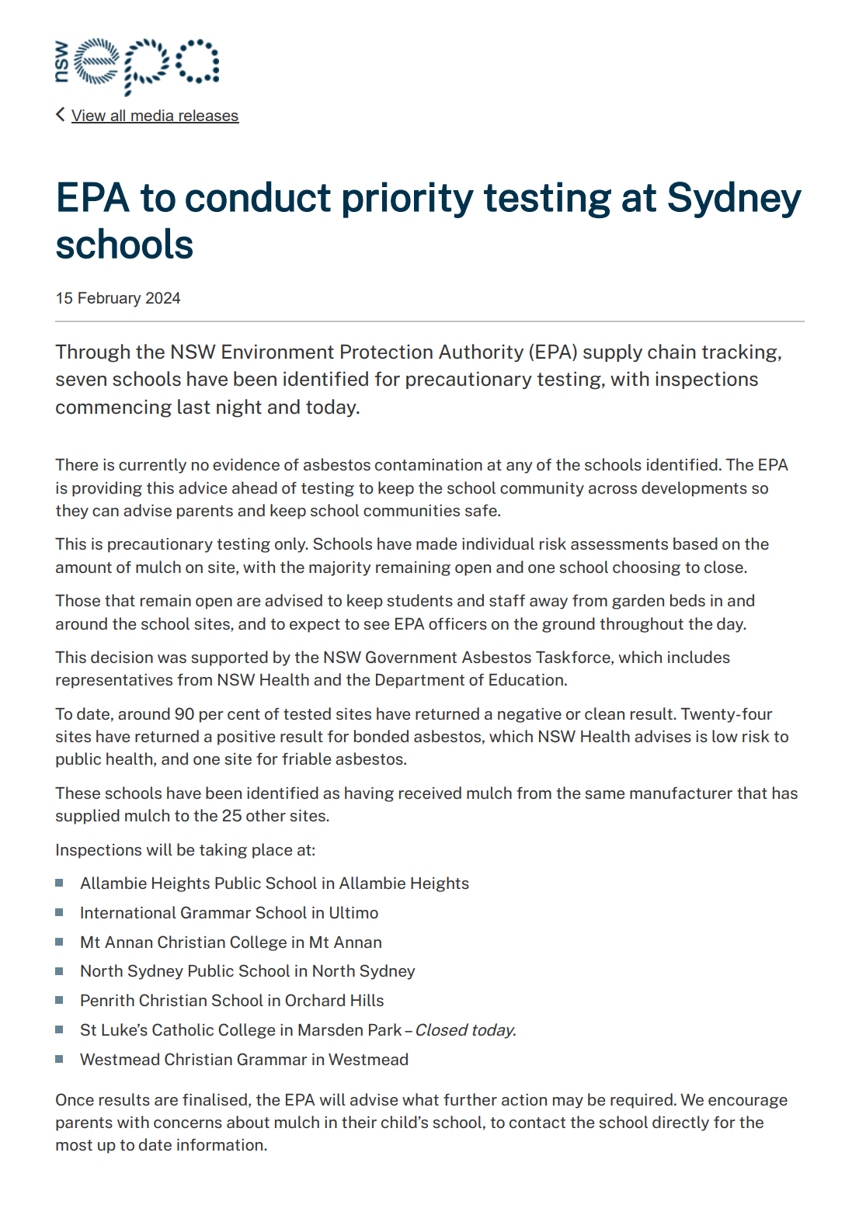
Media releases
Click here to view media release
Click here to view media release

Slide 10
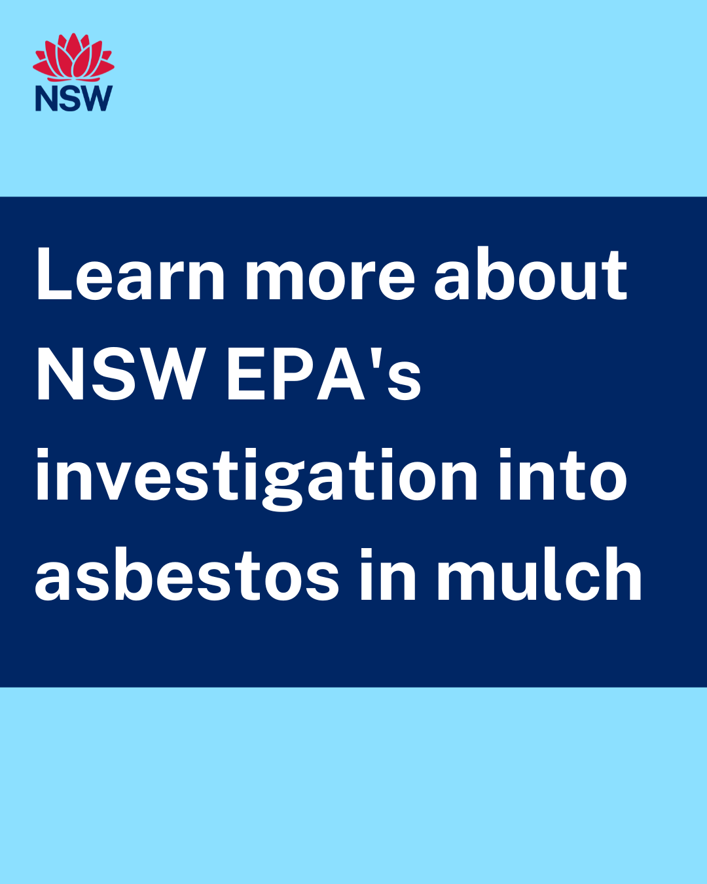
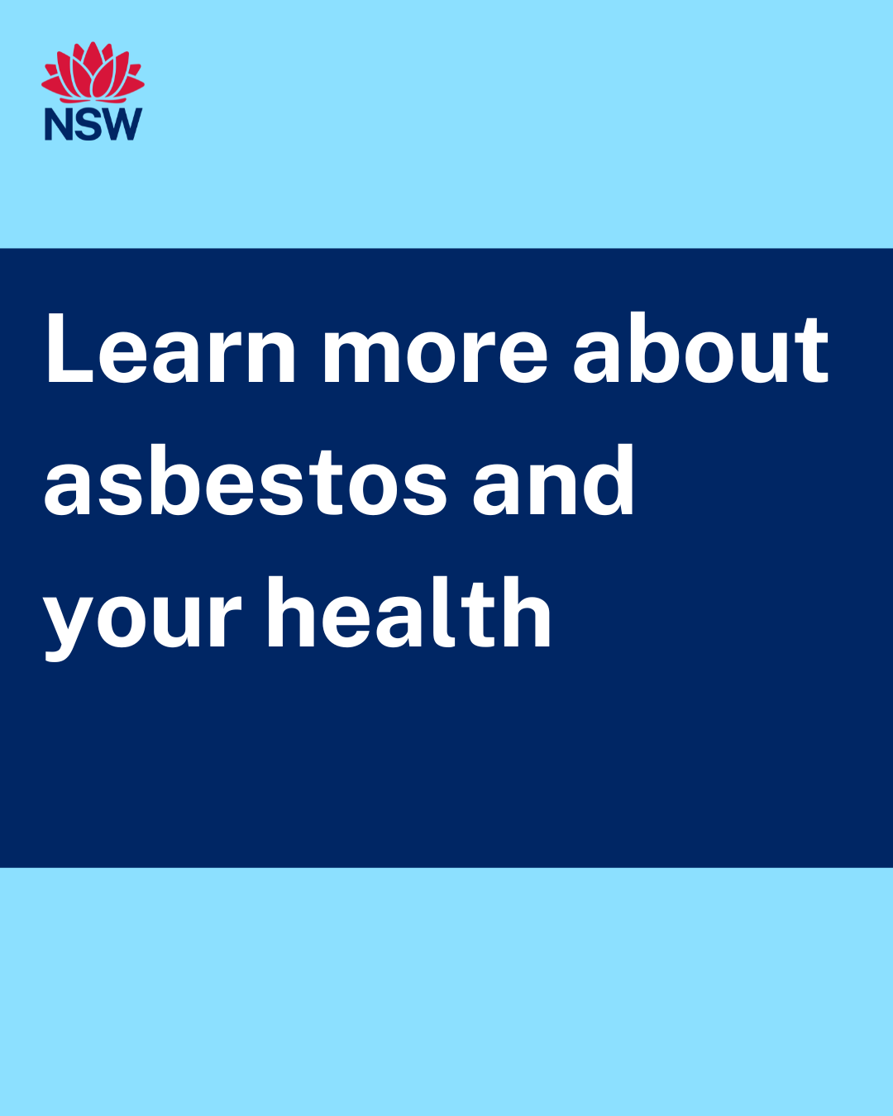
Social content
Click here to download social tile
Click here to download social tile
Post: An Asbestos Taskforce has been set up to support the NSW Environment Protection Authority’s investigation into asbestos in mulch. For more information, please visit the EPA website
Post: Living or working with asbestos, or just being around it, is a low health risk as long as the asbestos is in good condition and not disturbed. For more information on asbestos and health, please visit health.nsw.gov.au

Slide 11
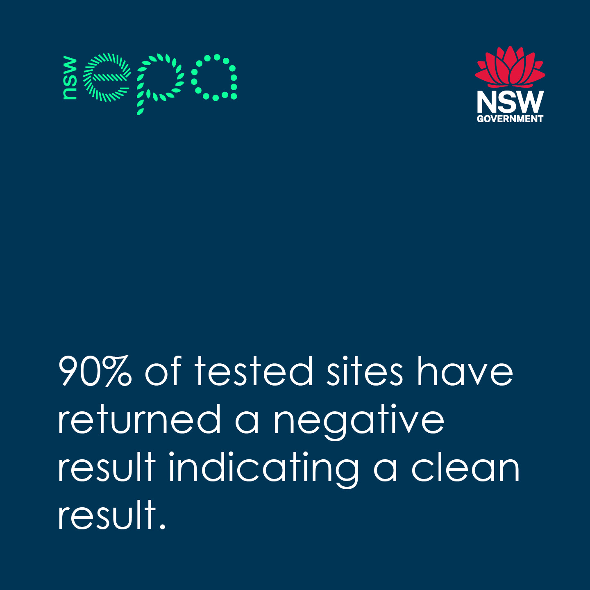
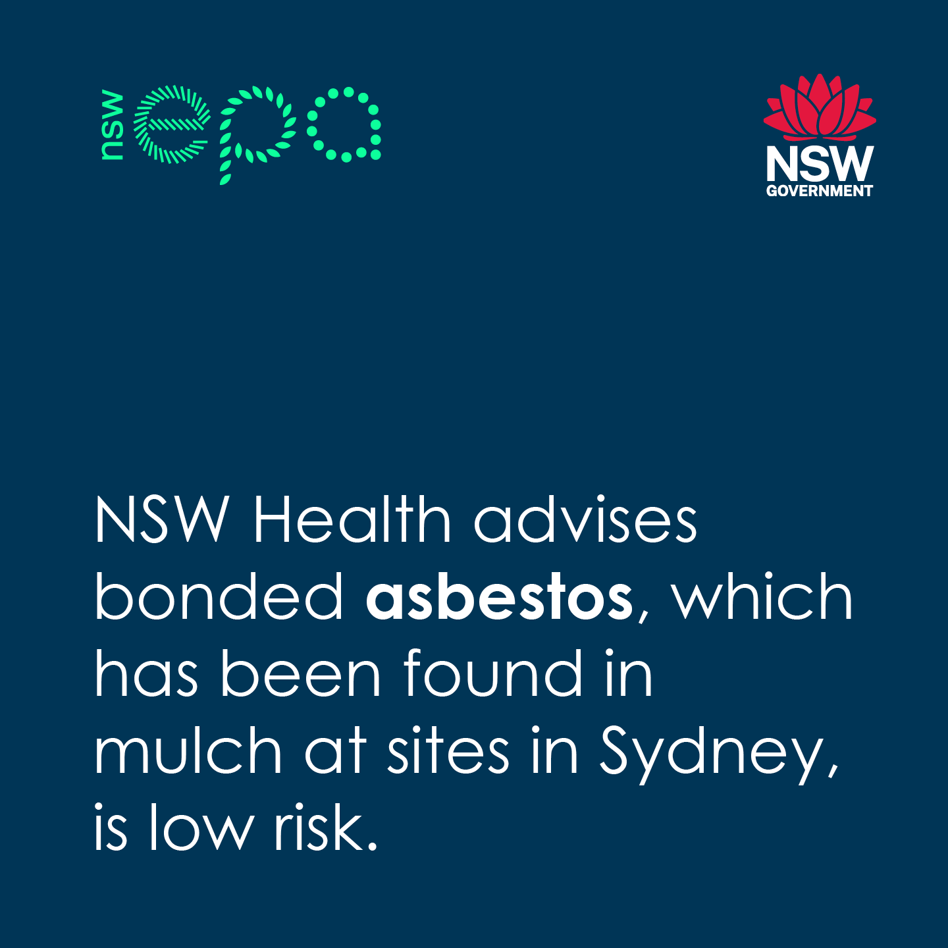
Social content
Click here to download social tile
Click here to download social tile
Post: The NSW Environment Protection Authority is investigating the discovery of asbestos in mulch. For more information, please visit the EPA website
Post: The NSW Environment Protection Authority is investigating the discovery of asbestos in mulch. For more information, please visit the EPA website

Slide 12
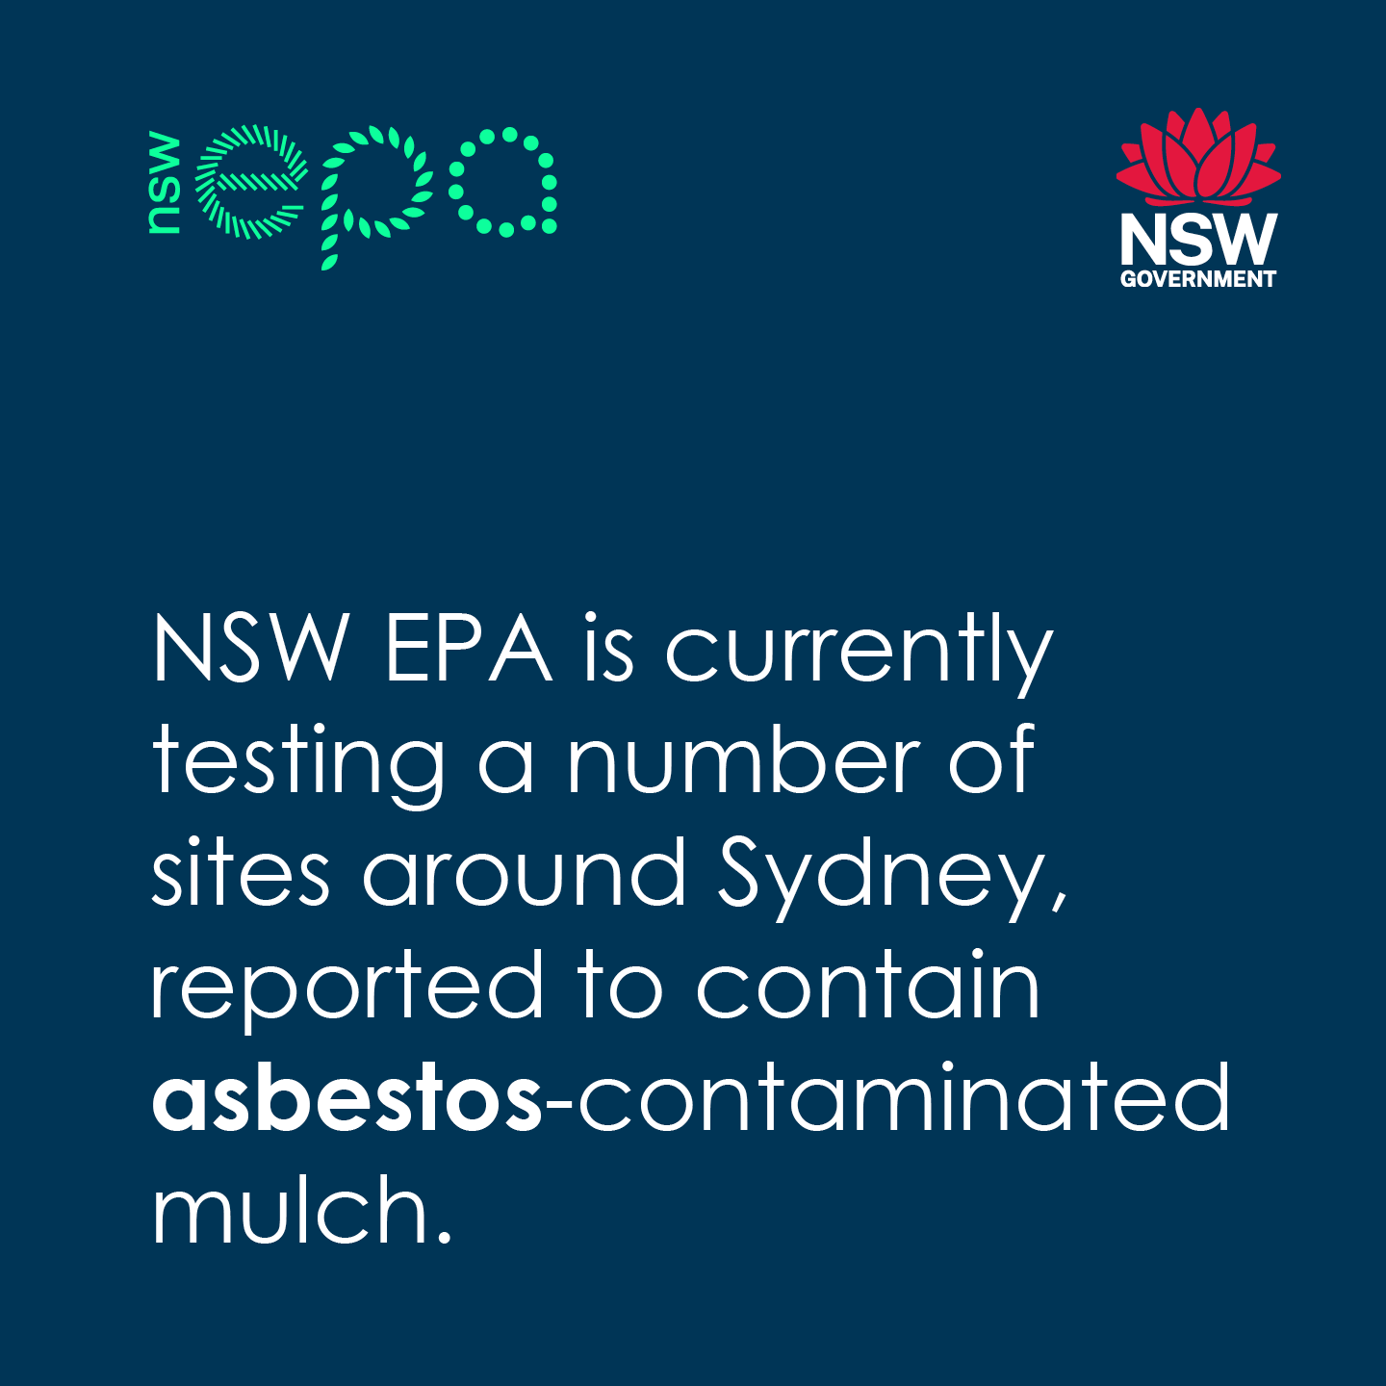
Social content
Click here to download social tile
Post: The NSW Environment Protection Authority is investigating the discovery of asbestos in mulch. For more information, please visit the EPA website

